Slide 1



Slide 2

CORE FUNCTIONS
User Level Access
Import/Export Workload
Workload Queue Management
Assigning of Workloads (Team Level)
Workload Data History
Based on Access
Dashboard
PR Queue

Slide 3
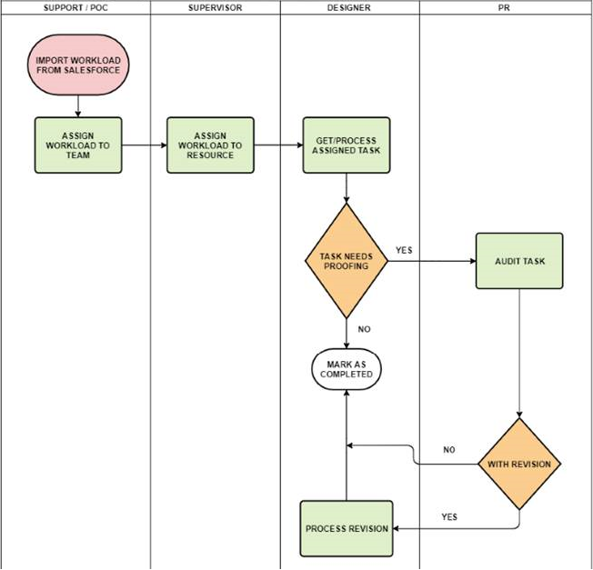
PROCESS FLOW
FOR FI-MODS / MODS / FULL MIGRATION
ONCE the TASK is COMPLETED, STATUS SHOULD BE CHANGED TO FOR PR
IT WILL THEN BE TRANSFFERED TO PR QUEUE
FOR PR/s
AFTER AUDITING THE TASK, STATUS SHOULD BE CHANGED TO PR DONE OR FOR REVISION.
TASK WILL THEN BE TRANSFFERED TO THE DESIGNER
FOR DESIGNER/s
IF STATUS IS PR DONE, THEY JUST NEED TO CHANGE IT TO COMPLETED
IF IT REQUIRES REVISION, PROCESS REVISION THEN CHANGE STATUS TO COMPLETED

Slide 4
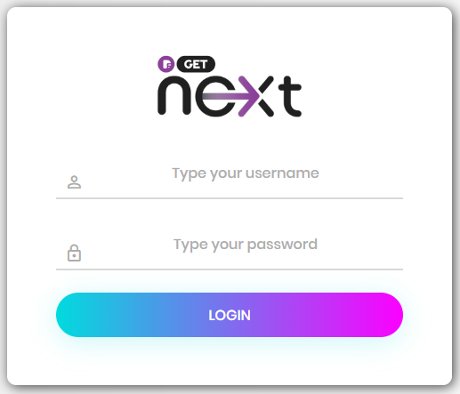
LOGIN SCREEN
Go to link http://10.11.162.215/
Login using your credentials

Slide 5

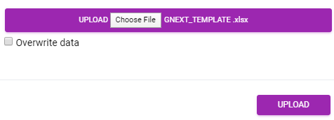

ADMIN/SUPPORT
IMPORT WORKLOAD
Click on IMPORT button.
Use the provided template and populate the needed data.
Click on UPLOAD button.
OVERWRITE DATA is normally used when assigning the workload to counterpart.
EXPORT WORKLOAD
Click on EXPORT to download the current work queue.
ADD – For manually adding WORKLOAD.
CLEAR – Use this button to clear all COMPLETED task from the QUEUE.
UPDATE – To make changes/edits on a specific WORKLOAD.
DELETE – Delete the WORKLOAD from the QUEUE.
SUMMARY – To show the summary dashboard.

Slide 6
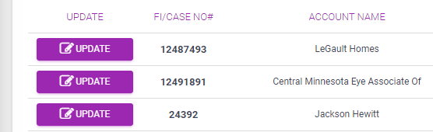
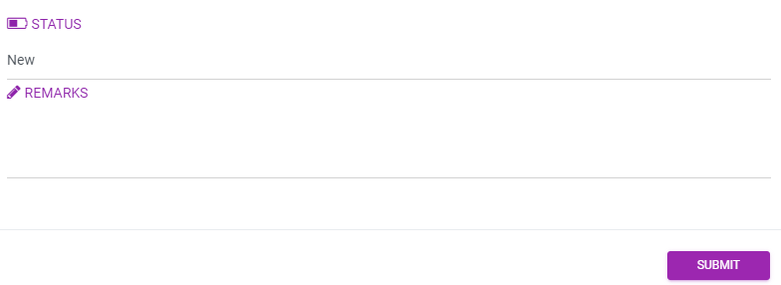
SUPERVISOR / POC
ADD – Manually ADD WORKLOAD
UPDATE
Click on button to assign task to RESOURCE
RESOURCE
CHANGE STATUS – To update the STATUS of the CURRENT WORKLOAD
Resource can also ADD REMARKS just is case it’s needed by PR/s

Slide 7
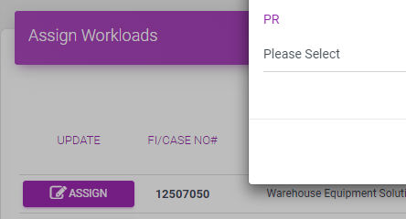
POC_PR
ASSIGN – To assign cases to PR/s for AUDIT.
PR
CHANGE STATUS – To update the STATUS of the CURRENT AUDIT TASK
PR/s can either select PR DONE or PR REVISION
PR/s can also add REMARKS.

Slide 8
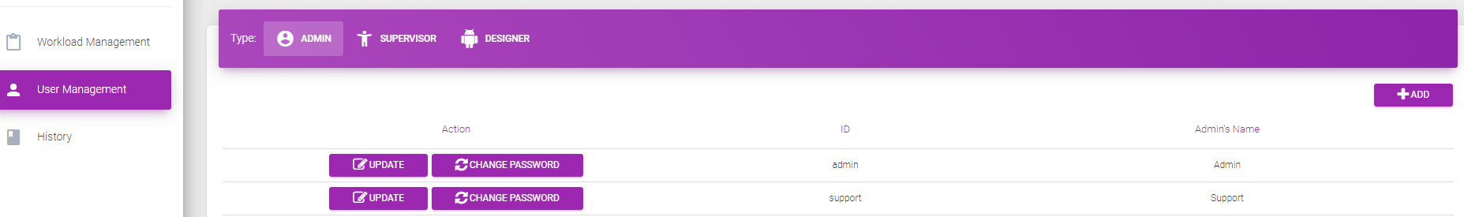
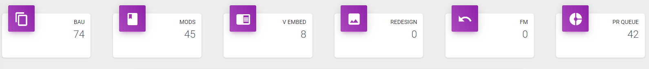
MISC
USER MANAGEMENT TAB
Section to add USERS
Change PASSWORD
HISTORY TAB
Section to view HISTORY
DASHBOARD – To see the current overview of the WORKLOAD QUEUE.

Slide 9
S
O
Strengths
Opportunities
User Level Access
History (Database Driven)
Efficient / Intuitive
Modular – Open to Future Enhancement
Cross Tower Implementation
Integration to Other Project/s
W
T
Weaknesses
Threats
Manual Importing of Workload
Data Not In Sync with Salesforce
System Downtime
STRENGTHS | ACTION PLAN | OWNER | TIMELINE | STATUS
User Level Access | Pruning of Inactive Users | Carlo | Q2 | OPEN
History (Database Driven) | Backing-Up Data | Paul |  | OPEN
Efficient / Intuitive | UI Enhancements | Paul |  | OPEN
Modular – Open to Future Enhancement | Gather Insights from Team | Carlo/Paul/Mark |  | OPEN
WEAKNESSES
Manual Importing of Workload | Exploring Options for Possible Automation | Paul/Mark | Q2 | OPEN
Data Not In Sync with Salesforce | Exploring Options for Possible Automation | Paul/Mark |  | OPEN
OPPORTUNITIES
Cross Tower Implementation | Feasibility Study | Carlo/Paul/Mark | Q2 | OPEN
Integration to Other Project/s | Feasibility Study | Carlo/Paul/Mark |  | OPEN
THREATS
System Downtime | Local Deployment | Paul/Mark | Q2 | OPEN

Slide 10
PLACEHOLDER FOR SURVEY (UAT)

Slide 11
FAQ
Q. How to change password?
A. Go to the right upper right corner and click the person icon and click the change password button.
Q. What to do if you accidentally change the status?
A. Kindly ask POC, SUPPORT, TL for assistance.
Q. What to do if you forgotten/lost your password?
A. Kindly ask POC, SUPPORT, TL for assistance.
Q. How come I can’t view all other designer’s history?
Every user has different view on the history based on their level.
Q. How do I report BUGs/ERROR?
A. Please use this link. https://docs.google.com/spreadsheets/d/1zn3ZifNUQIazeBN6zZHyH9sahmZbd4rPPtosaToeR-k/edit#gid=0

